Slide 1


Hadith Series
40 Ahadith Compilation

Slide 2
Introduction to the book
The Author & the Book • Author: ‘Ali ibn Sultan Muhammad, also known as Mulla ‘Ali al-Qari
• Made hijra to Makkah from Herat • His teacher: Ibn Hajar al-Haytami
Famous works: Mirqat al-Mafatih Sharh Mishkat al-Masabih and many more!
• Passed away in Shawwal of 1014AH, buried in Makkah
• Why forty hadith?
- Many hadith mention the excellence of compiling forty
- Hadith included in Mulla ‘Ali al-Qari’s collection are concise
- Profound meaning in few words
- Easy to memorize/snippets of Hadith
Notes:
This is a note to learn

Slide 3
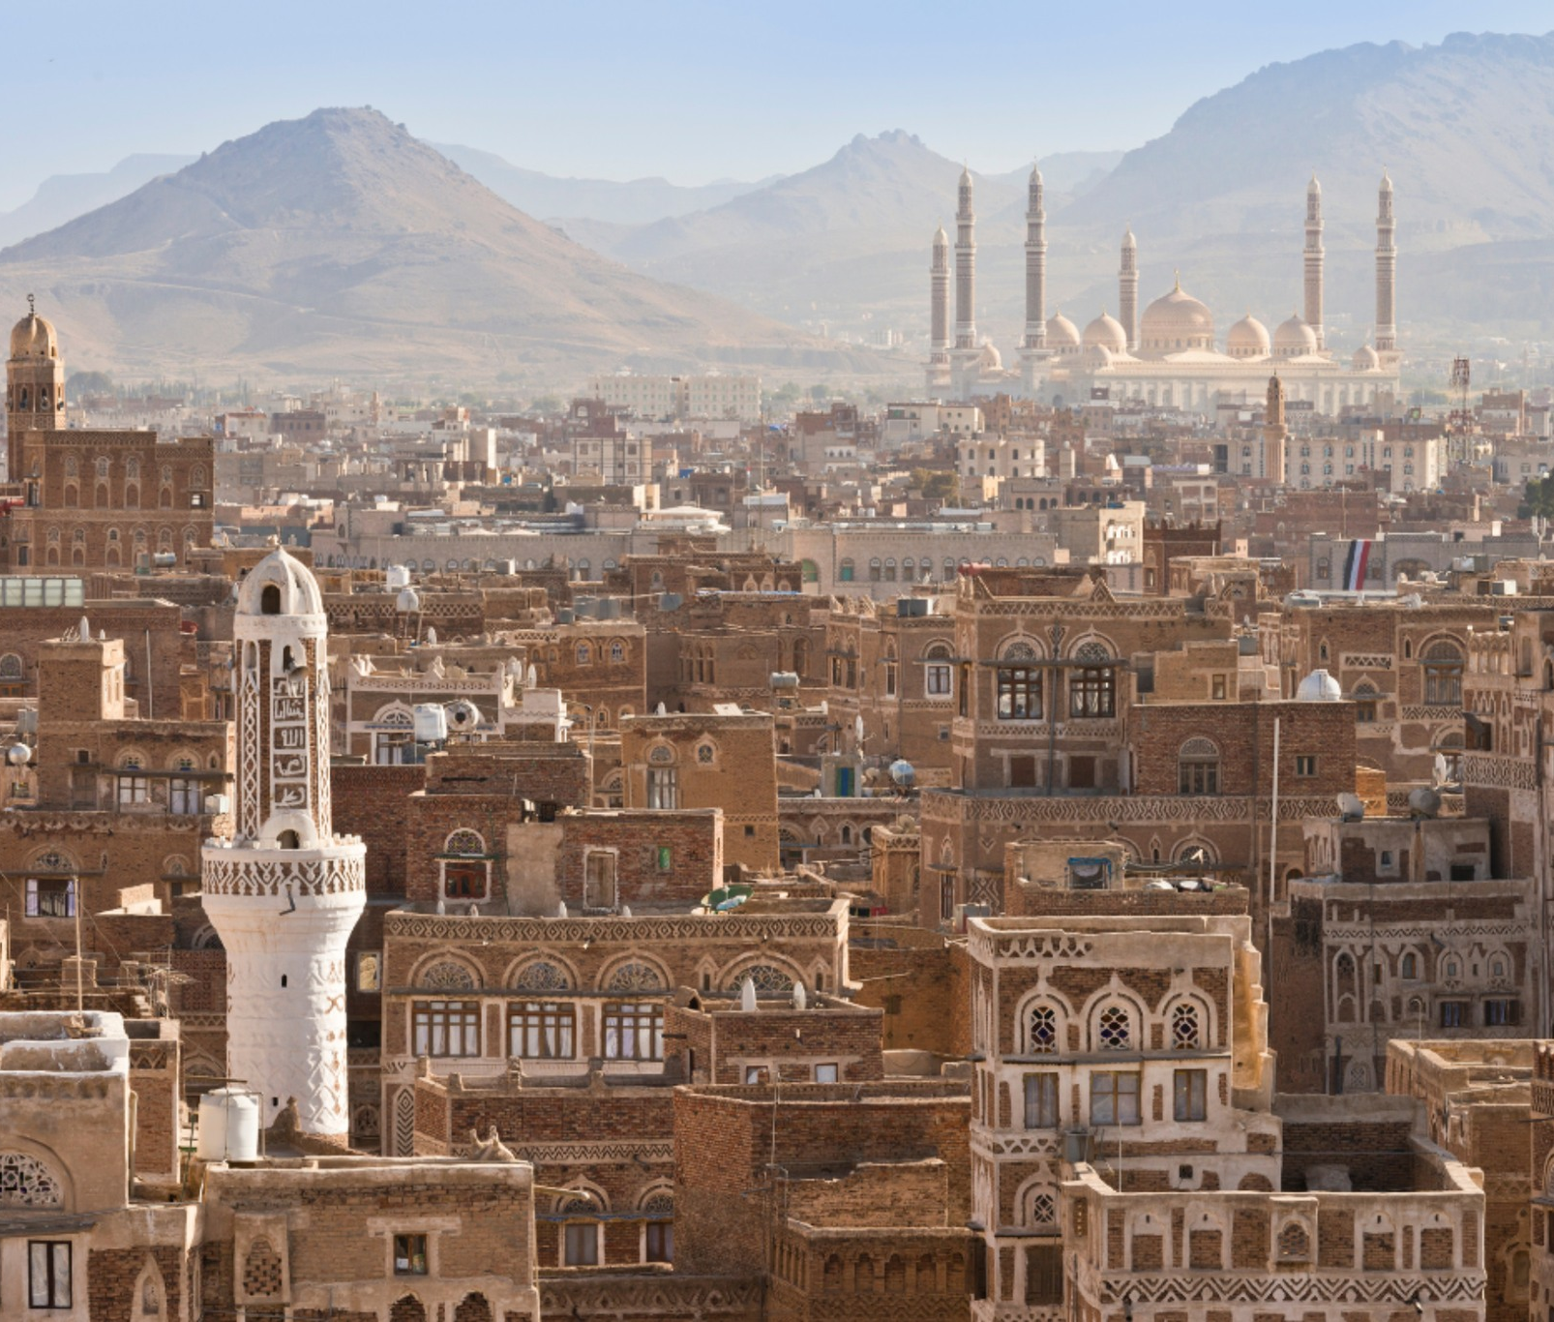
Hadith 1:
“Pride and arrogance are characteristics of the rural Bedouins, while calmness is found amongst the owners of sheep. Faith is Yemeni, and Wisdom is also Yemeni”

Slide 4

Hadith 1: Faith is Yemeni الإِيمَانُ يَمَانٍ
The Prophet's words
The Prophet (saw) said, "Faith (Iman) is Yemeni, understanding (Fiqh) is Yemeni and wisdom (Hikmah) is Yemeni".
The Prophet's actions
The Prophet (saw) also pointed towards Yemen and said, “Faith is there”.
Brief History
Yemen is significant in Islamic history because the Prophet (saw) descended from Yemen (Ancestry) and was sheltered by the descendants of Yemen. The Prophet's tribe, the Quraysh, are descendants of the Banu Jurhum, a pure Arab tribe from Yemen. The Ansar of Madinah, who took in the Prophet and Muhajirun, also have roots in Yemen.

Slide 5

Hadith 1: Faith is Yemeni "‏ الإِيمَانُ يَمَانٍ
Apparent meaning: praise for the people of Yemen! 1st to respond to the call for Hajj. 1st to initiate the shaking of hands.
At that time, Yemenis were receptive of the message and the prophet SAW had high hopes for them
Other interpretations: Makkans/Ansaris
Uways al-Qarni (r) Story: he is coming with Yemeni reinforcements. Mother.
• Takeaway: Consider, what do we want to be known by?

Slide 6
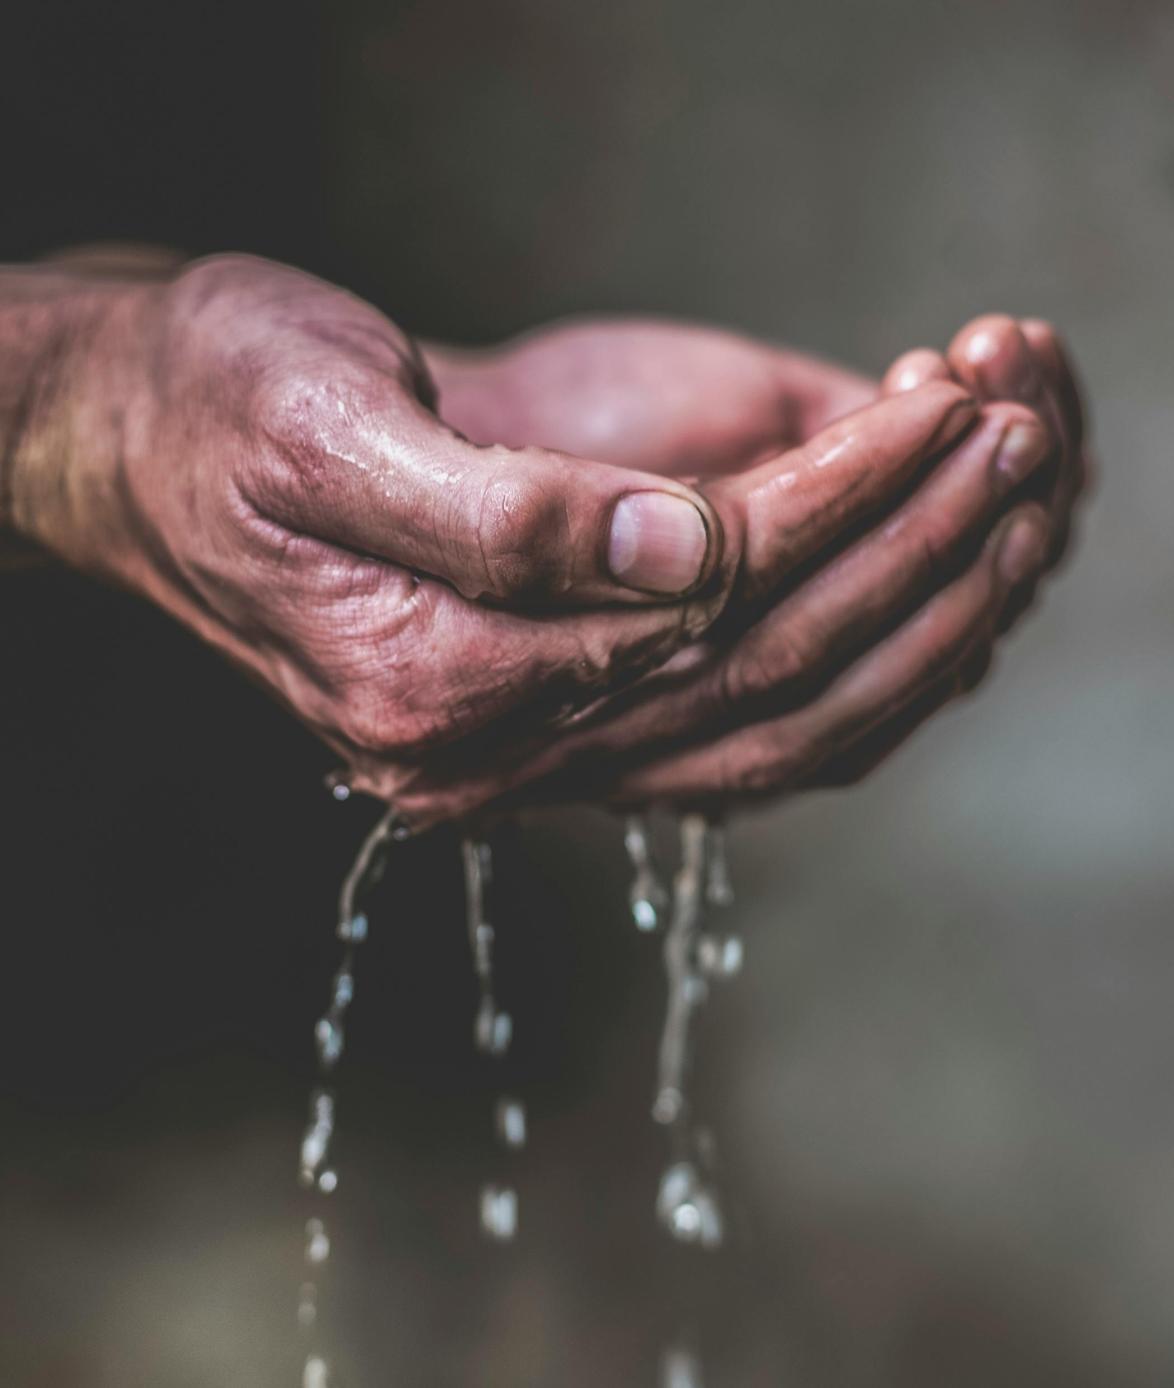
Hadith 2: To the right, then to the right. (Muslim/Bukhari)
• Context: One Sahabi had some Sheep’s milk mixed with water, and Prophet صلى الله عليه وسلم drank from it.
Abu Bakr was on his left; Bedouin was on his right. Prophet SAW gave it to Bedouin saying the above hadith (right side) to clarify what he was doing.
We know that the Most superior after the prophets is Abu Bakr RA but still gave it to his right!
• Explanation: tayaamum (beginning with the right) is of the Sunnah, mustahabb

Slide 7

Hadith 3: Your kin, your kin! (Ibn Hibban, Saheeh)
Context: The Prophet صلى الله عليه وسلم was ill and he said this, meaning one should keep good family ties. Direct family and extended family.
E.g., A man can't marry 2 sisters at one time due to the keeping family ties. Just because a mere possibility that this could happen.
If there is too much socializing between family members can lead to problems so keeping a healthy balance between family is very important.

Slide 8
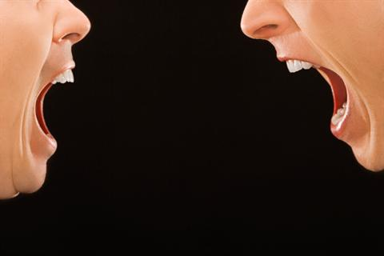
Hadith 3:
Quran Ra’ad 13:21 : …Those who join what Allah has commanded to join…these are the people of understanding
Hadith: …anyone who believes in the Allah and the last day should maintain his ties in kinship.
Hadith: …whoever desires expansion of his provisions (rizq)/to have the best of his life prolonged should maintain family ties. Barakah/long life
Hadith: those who maintain ties of kinship isnt the person who because others do it to broken, he does it back, rather when it is broken, he fixes it.
This Photo by Unknown Author is licensed under CC BY-SA-NC

Slide 9
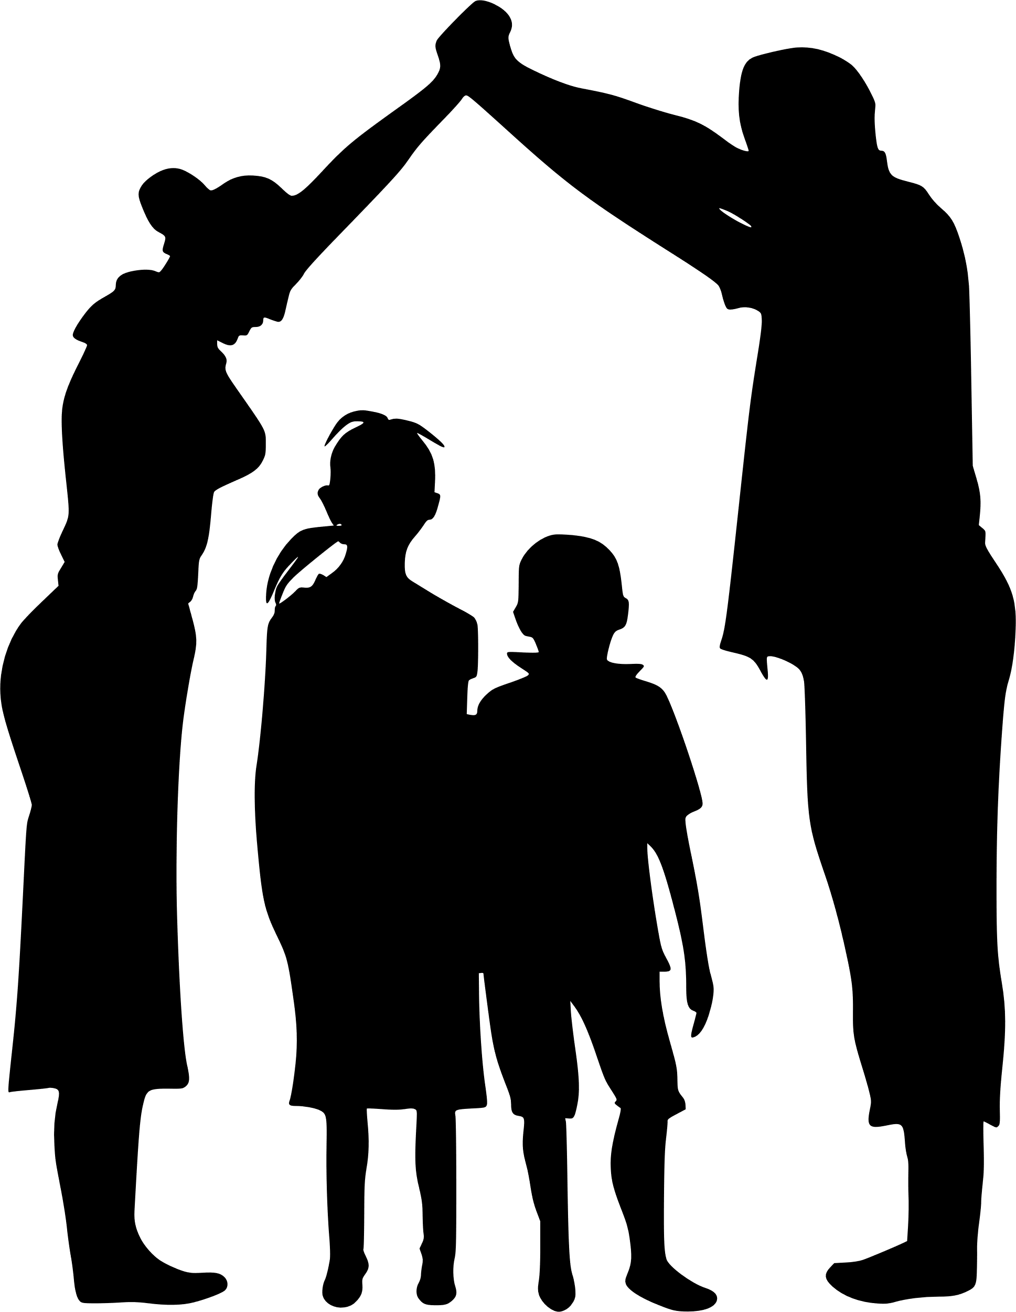
Hadith3:
Hadith: Kinship is suspended from the Throne of Allah and says: Allah will connect with all those who connect ties and sever with all those that sever ties.
Our relationship with Allah can depend on your family ties!
Hadith: The one who sever ties will not enter Jannah.
Zakat: Giving to poor relatives = 1 reward for poor, 1 reward for relatives.
It is a major sin to cut off ties with one’s kin, and one should do his/her best to maintain them
• Takeaway: Look after relatives financially if they’re in need.

Slide 10
Hadith 4: Intercede, and you will be rewarded “ اشْفَعُوا فَلْتُؤْجَرُوا ”
Intercession is mentioned in the Quran in Verse 4:85, and it is highly rewarding
من يَشْفَعْ شَفَـٰعَةً حَسَنَةًۭ يَكُن لَّهُۥ نَصِيبٌۭ مِّنْهَا ۖ وَمَن يَشْفَعْ شَفَـٰعَةًۭ سَيِّئَةًۭ يَكُن لَّهُۥ كِفْلٌۭ مِّنْهَا ۗ وَكَانَ ٱللَّهُ عَلَىٰ كُلِّ شَىْءٍۢ مُّقِيتًۭا ٨٥
Whoever intercedes for a good cause will have a share in the reward, and whoever intercedes for an evil cause will have a share in the burden. And Allah is Watchful over all things.
Use intercession at your advantage! Don’t shy away from interceding if you are in the position to do so!
• Two types of intercession:
1- Good (intercession for someone who is deserving)
2- Bad (intercession for sin or someone who is not deserving)
FULL HADITH - Bukhari (5568) and Muslim (4761) narrated that Abu Musa (may Allah be pleased with him) said that if someone came with a need to the Messenger of Allah (peace and blessings of Allah be upon him), he would turn to those who were sitting with him and say, “Intercede, and you will be rewarded, and Allah will decree what He wills through the lips of His Messenger.”

Slide 11
Hadith 4: Intercede, and you will be rewarded “ اشْفَعُوا فَلْتُؤْجَرُوا ”
Scenarios:
• Some people are unable to articulate Or they are capable but do not have the right connections, or they have a language barrier - If one is able to intercede for these people, it is highly rewarding.
• Intercession is putting in a good word, and we can’t force someone to accept it
A bad intercession defined:
An intercession for the undeserving is equally blameworthy. It is helping them in sin. Whether it is a reference letter or something dubious, just beware, do your due diligence.
The reality of intercession: Simply putting in a good word • “Consider” is the key word • We shouldn’t have any expectations:
Example from the Prophet (s)’s life – He interceded for a person called Mugith RA about keeping Bareera RA in his marriage – she said “is this a command or a just a suggestion?
• Takeaway: Help our fellow brothers and sisters, especially the weak and marginalized. Hadith: “Allah aids his slave as long as he aids his brother” (Muslim) • To advocate for the weak, marginalized and downtrodden is highly virtuous

Slide 12

Hadith 5: Announce the marriage. “أَعْلِنُوا هَذَا النِّكَاحَ ”
Meaning: Solemnise in a mosque to make it known – holding a Walima – and use a permissible Drum/Duff. Announcement is what differentiates marriage and fornication
Virtues of Nikah:
Why get married?
“”Marriage is part of my sunnah, and whoever does not follow my sunnah has nothing to do with me. Get married, for I will boast of your great numbers before the nations. Whoever has the means, let him get married, and whoever does not, then he should fast for it will diminish his desire.”
When to get married?
The prophet (peace be upon him) said:
“O young men, those amongst you who can afford to get married, should marry – for this will be a means of restraining the eyes from casting evil glances and keeping one pure and chaste” (Bukhari, Muslim)
Full hadith
“Announce this marriage publicly, conduct it in the mosque, and strike the drums for it.”
Sunan al-Tirmidhī 1089

Slide 13
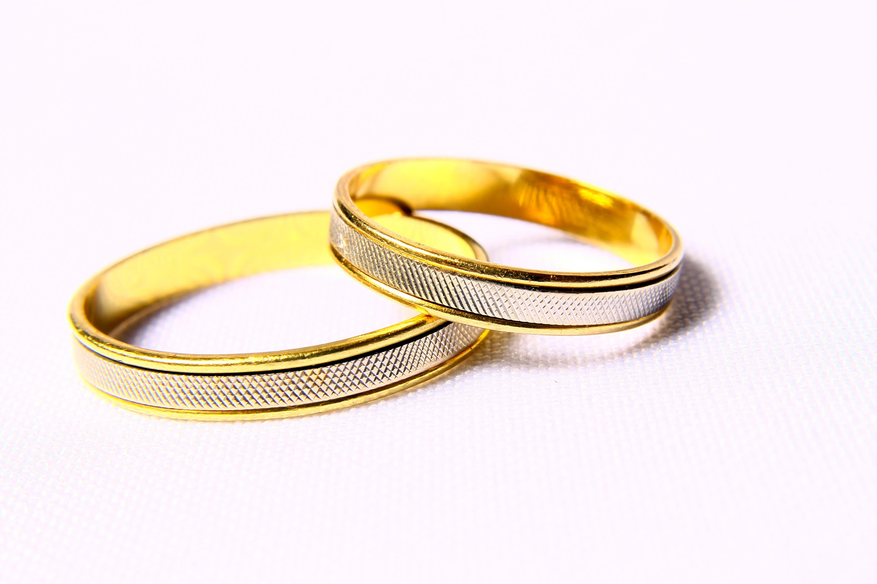
Hadith 5: Announce the marriage. “أَعْلِنُوا هَذَا النِّكَاحَ ”
Nikah is a sunnah, should not be delayed!
Who should marry?
Sunnah mu’akkadah for people with moderate sexual desires; waajib for those with high levels
What constitutes a Nikah in the Sharia?
• An offer and acceptance • Presence of witnesses • Considering in the light of our hadith today: •
Majority understood “announce” to be recommended or fulfilled by witnesses • Announcing is still mustahabb • Some fuqaha consider this a condition for marriage to be valid!
• Better to announce in large gathering

Slide 14
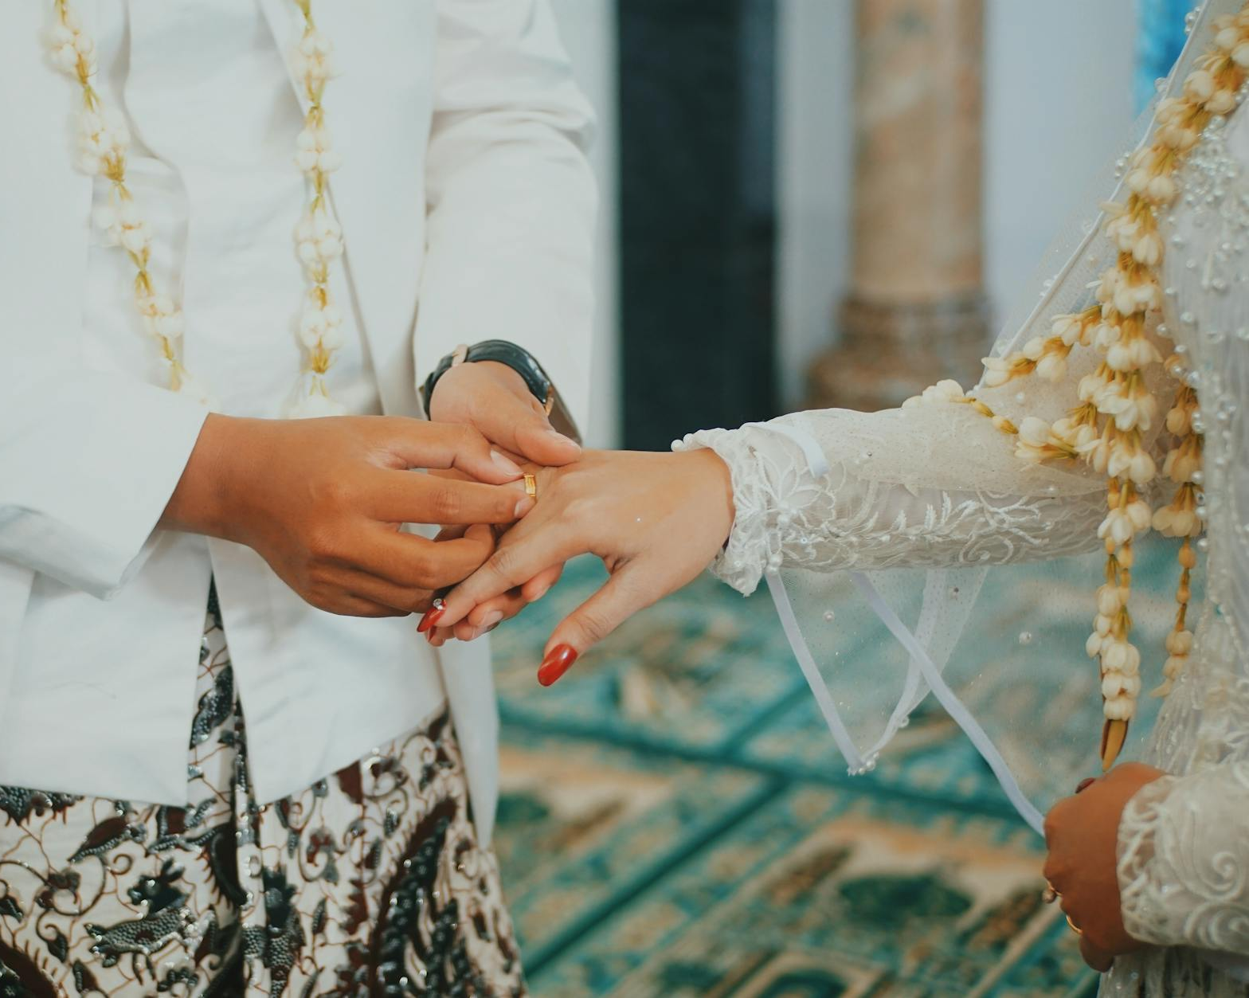
Hadith 5: Announce the marriage. “أَعْلِنُوا هَذَا النِّكَاحَ ”
“Secret Nikahs” : There is no such thing as a secret Nikah, (it still has witnesses) it is an oxymoron
How ethical is it? Is it in the spirit of Sunnah? If they got caught, accusations can fly easily about.
The upper limit: Don’t overdo the announcement (social media, pictures etc)
The lower limit: Don’t under-do it – not even telling your other wife etc
Consequences of secretive nikahs

